Slide 1
Database Management Systems
Transactions
Mohammad Imam Hossain, Lecturer, Dept. of CSE, UIU

Slide 2
Transactions
2
A collection of several operations on the database appears to be a single unit from the point of view of the database user.
For example, a transfer of funds from a checking account to a savings account is a single operation from the customer’s standpoint; within the database system, however it consists of several operations. It is essential that all these operations occur, or that, in case of a failure, none occur.
Collections of operations that form a single logical unit of work are called transactions.
A database system
must ensure proper execution of transactions despite failures either the entire transaction executes, or none of it does.
must manage concurrent execution of transactions that avoids inconsistency.
A transaction is a unit of program execution that accesses and possibly updates various data items.
Usually, a transaction is initiated by a user program written in a high-level data-manipulation language (typically SQL), or programming language (e.g. C++ or Java), with embedded database accesses in JDBC or ODBC.
A transaction is delimited by statements (or function calls) of the form begin transaction and end transaction. The
transaction consists of all operations executed between the begin transaction and end transaction.

Slide 3
Transaction Properties – A C I D
3
Atomicity – Either all operations of the transaction are reflected properly in the database, or none are.
Consistency – Execution of a transaction atomically in isolation preserves the consistency (both data integrity constraints and application-dependent constraints) of the database.
Isolation – Even a single SQL statement involves many separate accesses to the database, and a transaction may consist of several SQL statements. Therefore, the database system must take special actions to ensure that transactions operate properly without interference from concurrently executing database statements. The system must guarantee that, for every pair of transactions T_{i} and T_{j}, it appears to T_{i} that either T_{j} finished execution before T_{i} started or T_{j} started execution after T_{i} finished. Thus, each transaction is unaware of other transactions executing concurrently in the system.
Durability – After a transaction completes successfully, the changes it has made to the database persist, even if there are system failures.

Slide 4
Transaction Model
4
As SQL is a powerful and complex language, we begin with a simple database language that focuses on when the data are moved from disk to main memory and from main memory to disk.
The data items in our simplified model contain a single data value and each data item is identified by a name (ex. A, B, X etc.)
Transactions access data using two operations:
read(X) : transfers the data item X from the database to a variable, also called X, in a buffer in main memory belonging to the transaction that executed the read operation.
write(X) : transfers the value in the variable X in the main-memory buffer of the transaction that executed the write to the data item X in the database.
Let, T_{i} be a transaction that transfers $50 from account A to account B. This transaction can be defined as:
read(A);
A := A – 50;
write(A);
read(B);
B := B + 50;
write(B);

Slide 5
Transaction Properties – ACID
5
Let, T_{i} be a transaction that transfers $50 from account A to account B. This transaction can be defined as:
read(A);
A := A – 50;
write(A);
read(B);
B := B + 50;
write(B);
A = Atomicity (all or nothing)
If the transaction fails after step 3 and before step 6, money will be lost leading to an
inconsistent database state. Failure could be due to software or hardware.
The system should ensure that updates of a partially executed transaction are not reflected in the database.
The basic idea behind ensuring atomicity is: The database system keeps track (on disk) of the old values of any data on which a transaction performs a write. This information is written to a file called the log.

Slide 6
Transaction Properties – ACID
6
Let, T_{i} be a transaction that transfers $50 from account A to account B. This transaction can be defined as:
read(A);
A := A – 50;
write(A);
read(B);
B := B + 50;
write(B);
D = Durability (changes stay)
Once the user has been notified that the transaction has completed the updates to the database, it must be the case that no system failure can result in a loss of data corresponding to this transaction.
We can guarantee durability by ensuring any of the following:
i) The updates carried out by the transaction have been written to disk before the
transaction completes.
ii) Information about the updates carried out by the transaction is written to disk, and such information is sufficient to enable that database to reconstruct the updates when the database system is restarted after the failure.

Slide 7
Transaction Properties – ACID
7
Let, T_{i} be a transaction that transfers $50 from account A to account B. This transaction can be defined as:
read(A);
A := A – 50;
write(A);
read(B);
B := B + 50;
write(B);
C = Consistency (Rules are preserved)
In general consistency requirements are of 2 kinds:
Explicit integrity constraints such as primary keys and foreign keys
Implicit integrity constrains such as the sum of A and B is unchanged by the execution of the transaction T_{i}
A transaction when starting to execute must see a consistent database.
During transaction execution the database may be temporarily inconsistent.
When the transaction completes successfully the database must be consistent.
Ensuring consistency for an individual transaction is the responsibility of the application programmer who codes the transaction. This task may be facilitated by automatic testing of integrity constraints.

Slide 8
Transaction Properties – ACID
8
I = Isolation (No interference)
Even if the consistency and atomicity properties are ensured for each transaction, if several transactions are executed
concurrently, their operations may interleave in some undesirable way, resulting in an inconsistent state.
The isolation property of a transaction ensures that the concurrent execution of transactions results in a system state that is equivalent to a state that could have been obtained if these transactions executed one at a time in some order.
If between steps 3 and 6 (of the fund transfer transaction), another transaction T2 is allowed to access the partially updated database, it will see an inconsistent database (the sum A + B will be less than it should be).
T1 T2
--------------------------------------------------------------
read(A)
A := A – 50
write(A)
read(A), read(B), print(A+B)
read(B)
B := B + 50
write(B)
A way to avoid the problem of concurrently executing transactions is to execute transactions serially (i.e. one after the other). However, executing multiple transactions concurrently has significant benefits.

Slide 9
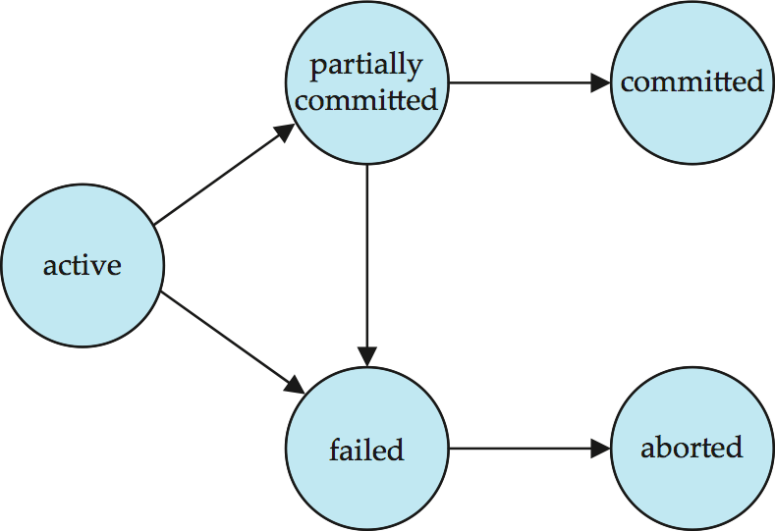
Transaction States
9
Active – The initial state; the transaction stays in this state while it is executing.
Partially committed –After the final statement has been executed. At this point the transaction has completed its execution, but it is still possible that it may have to be aborted, since the actual output may still be temporarily residing in main memory, and thus a hardware failure may preclude its successful completion.
Failed – After the discovery that normal execution can no longer
proceed with its normal execution.
Aborted –After the transaction has been rolled back, then it enters the aborted state. Two options after it has been aborted:
restart the transaction for hardware or software error.
kill the transaction for logical error
Committed – After successful completion

Slide 10
Concurrent Execution
10
Transaction-processing systems usually allow multiple transactions to run concurrently.
Advantages are:
Improved throughput and resource utilization: The parallelism of the CPU and I/O system can therefore be exploited to run multiple transactions in parallel. While a read or write on behalf of one transaction is in progress on one disk, another transaction can be running in the CPU, while another disk may be executing a read/write on behalf of 3rd transactions.
Reduced average response time: short transactions need not wait behind long ones. If the transactions are operating on different parts of the database, it is better to let them run concurrently, sharing the CPU cycles and disk accesses among them.

Slide 11
Schedule & Serial Schedule
11
Schedule
A sequences of instructions that specify the chronological order in which instructions of concurrent transactions are executed.
A schedule for a set of transactions must consist of all instructions of those transactions
Must preserve the order in which the instructions appear in each individual transaction.
Serial Schedule
Each serial schedule is a schedule that consists of a sequence of instructions from various transactions, where the instructions belonging to one single transaction appear together in that schedule.
For a set of n transactions there exists n! different valid serial schedules but we can’t predict how many schedules are
possible in total (it depends on the OS and hardware).

Slide 12
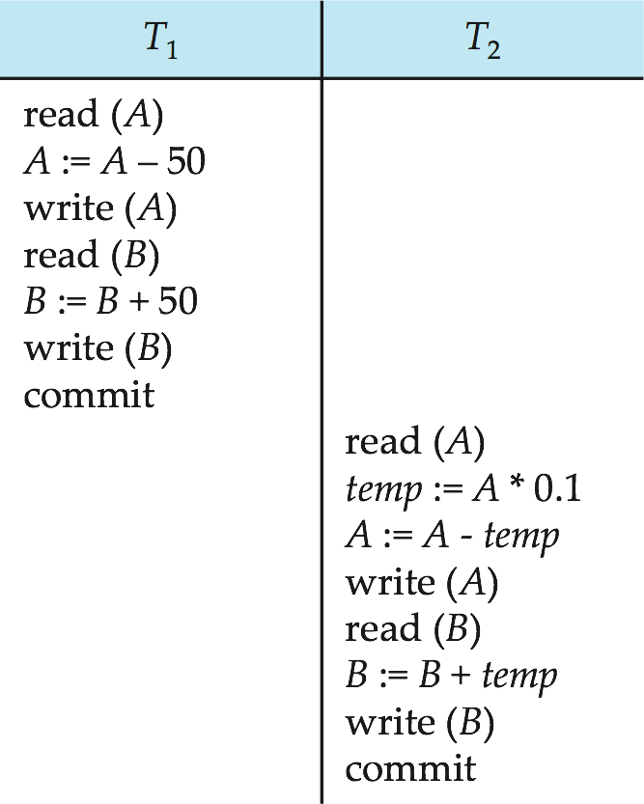
Schedule 1
12
Let T₁ transfer $50 from A to B, and T₂ transfer 10% of the balance from A to B.
Initial balance:
A = 1000$ and
B = 2000$
950
An example of a serial schedule in which T₁ is followed by T₂ :
2050
855
2145

Slide 13
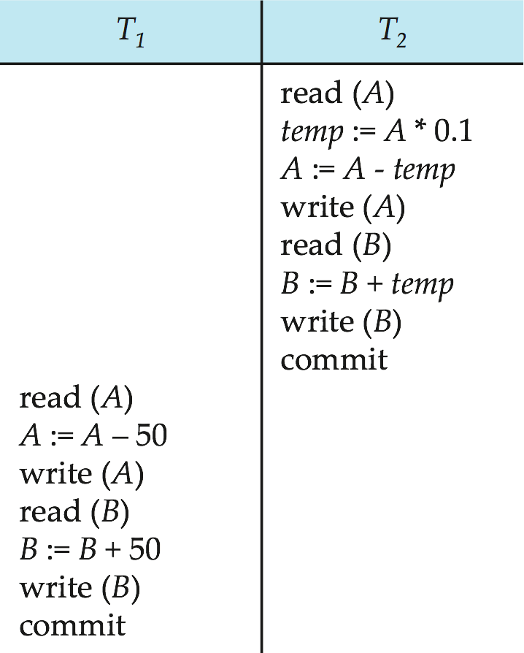
Schedule 2
13
Let T₁ transfer $50 from A to B, and T₂ transfer 10% of the balance from A to B.
Initial balance:
A = 1000$ and
B = 2000$
900
An example of a serial schedule in which T₂ is followed by T₁ :
2100
850
2150

Slide 14
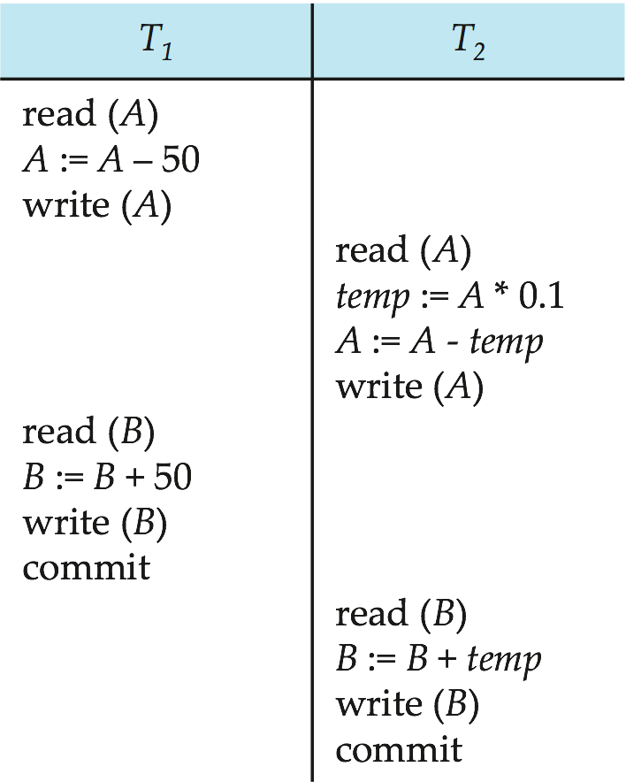
Schedule 3
14
Let T₁ transfer $50 from A to B, and T₂ transfer 10% of the balance from A to B.
Initial balance:
A = 1000$ and
B = 2000$
950
950
Let T₁ and T₂ be the transactions defined previously. The following schedule is not a serial schedule, but it is equivalent to Schedule 1.
In schedule 1, 2 and 3 the sum ‘A+B’ is preserved.
855
2050
2050
2145

Slide 15
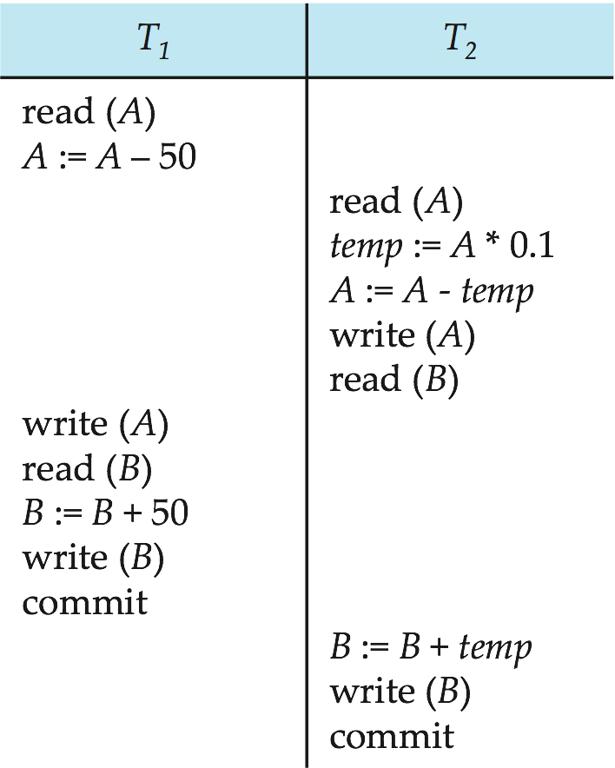
Schedule 4
15
Let T₁ transfer $50 from A to B, and T₂ transfer 10% of the balance from A to B.
Initial balance:
A = 1000$ and
B = 2000$
1000
1000
The following concurrent schedule does not preserve
the sum of “A + B”
900
950
2000
2050
2100

Slide 16
Classic Problems
Classic problems are undesired situations that occur due to concurrent execution of transactions.
Three classic problems are:
Lost Update
Uncommitted Dependency (Dirty Bit)
Inconsistent Analysis
Why Do These Problems Matter?
Occur due to concurrent execution of transactions
Violate Isolation property of ACID
Produce incorrect database results
Common in real-world systems (banking, payroll, reporting)

Slide 17
Lost Update
The Lost Update problem occurs when:
Two transactions read the same data item
Both update it
One update overwrites the other
Example:
Initial Balance: A = 100
T1 | T2
Read A (100)
A := A + 50
 | Read A (100)
 | A := A − 30
Write A (150)
 | Write A (70)
What’s the problem here?
Final Value = 70 Correct value should be 120

Slide 18
Uncommitted Dependency (Dirty Bit)
Occurs when:
A transaction reads data written by another transaction
The writing transaction has not committed yet
The writer later rolls back
Example:
T1 | T2
Write A := 500
 | Read A := 500
Rollback
 | A := 500+100
What’s wrong here?
T2 used a value that never officially existed, as the system rollback T1 transaction, which means A never existed here.

Slide 19
Inconsistent Analysis
Occurs when:
A transaction reads multiple data items
Another transaction updates some of them
The reading transaction sees a partial update
Example:
Initial Values: A = 100, B = 200 (Total = 300)
T1 (Analysis) | T2 (Update)
Read A = 100
 | Write A = 150
 | Commit
Read B = 200
What’s wrong here?
T1 calculates total = 300 Correct total = 350

Slide 20
How DBMS Prevents These Problems
DBMS prevents these classic problem using -
Concurrency Control Protocols
Lock-based protocols
Timestamp ordering
Transaction isolation levels

Slide 21
Serializability
16
If two transactions are running concurrently, the operating system may execute one transaction for a little while, then perform a context switch, execute the second transaction for some time, and then switch back to the first transaction for some time, and so on. With multiple transactions, the CPU time is shared among all the transactions.
If control of concurrent execution is left entirely to the operating system, many possible schedules, including ones that leave the database in an inconsistent state are possible. It is the job of database system to ensure that any schedule that is executed will leave the database in a consistent state. The concurrency-control component of the database system carries out this task.
Serial schedules are serializable, but if steps of multiple transactions are interleaved, it is harder to determine whether a
schedule is serializable.
A (possibly concurrent) schedule is serializable if it is equivalent to a serial schedule.
Different forms of schedule equivalence give rise to the notions of:
Conflict Serializability
View Serializability
How to determine when a schedule is serializable!!!

Slide 22
Conflicting Instructions
17
Let l_{i} and l_{j} be two Instructions of transactions T_{i} and T_{j} respectively. Instructions l_{i} and l_{j} conflict if and only if there exists some item Q accessed by both l_{i} and l_{j}, and at least one of these instructions wrote Q.
l_{i} = read(Q), l_{j} = read(Q). l_{i} and l_{j} don’t conflict.
l_{i} = read(Q), l_{j} = write(Q). They conflict.
l_{i} = write(Q), l_{j} = read(Q). They conflict.
l_{i} = write(Q), l_{j} = write(Q). They conflict.
Intuitively, a conflict between l_{i} and l_{j} forces a (logical) temporal order between them.
If l_{i} and l_{j} are consecutive in a schedule and they do not conflict, their results would remain the same even if they had been interchanged in the schedule.

Slide 23
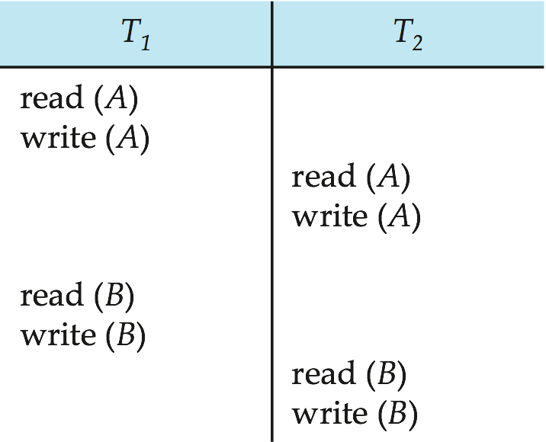
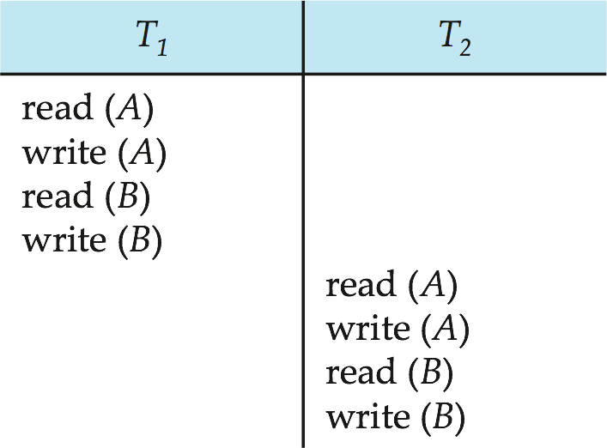
Conflict Serializability
18
If a schedule S can be transformed into a schedule S’ by a series of swaps of non-conflicting instructions, we say that S and
S’ are conflict equivalent.
We say that a schedule S is conflict serializable if it is conflict equivalent to a serial schedule
For example: Schedule S can be transformed into Schedule S’ that is serial. So, Schedule S is conflict serializable.
Schedule, S
Conflict Serializable Schedule, S’

Slide 24
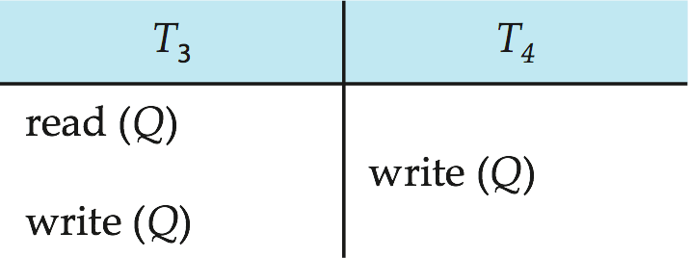
Conflict Serializability
19
If a schedule S can be transformed into a schedule S’ by a series of swaps of non-conflicting instructions, we say that S and
S’ are conflict equivalent.
We say that a schedule S is conflict serializable if it is conflict equivalent to a serial schedule
For example: Schedule S can not be transformed into a schedule that is serial. So, Schedule S is not conflict serializable.
Not conflict serializable schedule, S

Slide 25
Precedence Graph
20
A simple and efficient method for determining the conflict serializability of a schedule.
Consider a schedule S. We construct a directed graph, called a precedence graph from S.
This graph consists of a pair G=(V, E), where V is a set of vertices and E is a set of edges.
Here,
V consists of all the transactions participating in the schedule.
E consists of all edges T_{i}→T_{j} for which one of 3 conditions holds:
T_{i} executes write(Q) before T_{j} executes read(Q)
T_{i} executes read(Q) before T_{j} executes write(Q)
T_{i} executes write(Q) before T_{j} executes write(Q)
If an edge T_{i} → T_{j} exists in the precedence graph, then in any serial schedule S’ equivalent to S, T_{i} must appear before T_{j}

Slide 26
Precedence Graph – Example 1
21
T₁
T₂

Slide 27
Precedence Graph – Example 2
22
T₂
T₁

Slide 28


Precedence Graph – Example 3
23
T₁
T₂
If the precedence graph for S has a cycle, then the schedule S is not conflict serializable.
If the graph contains no cycles, then the schedule S
is conflict serializable.

Slide 29




Serializability Order
24
A serializability order of the transactions can be obtained by finding a linear order consistent with the partial order of the precedence graph. This process is called topological sorting.
There are, in general several possible linear orders that can be obtained through a topological sort.
T_{i}
T_{i}
T_{j}
T_{k}
T_{m}
T_{j}
T_{k}
T_{i}
T_{k}
T_{j}
T_{m}
T_{m}

Slide 30




25
Conflict Serializability Check – 1
T₁
T₂
T₄
T₃
T₅

Slide 31

Conflict Serializability Check – 2
26
T1 | T2 | T3 | T4
Read(X)
 | Read(X)
Write(Y)
 |  | Read(Y)
 | Read(Y)
 | Write(X)
 |  | Read(W)
 |  | Write(Y)
 |  |  | Read(W)
 |  |  | Read(Z)
 |  |  | Write(W)
Read(Z)
Write(Z)
T₁
T₂
T₄
T₃
Serializability Order:
T₁ → T₃ → T₄ → T₁
or,
T₁ → T₂ → T₃ → T₄ → T₁

Slide 32
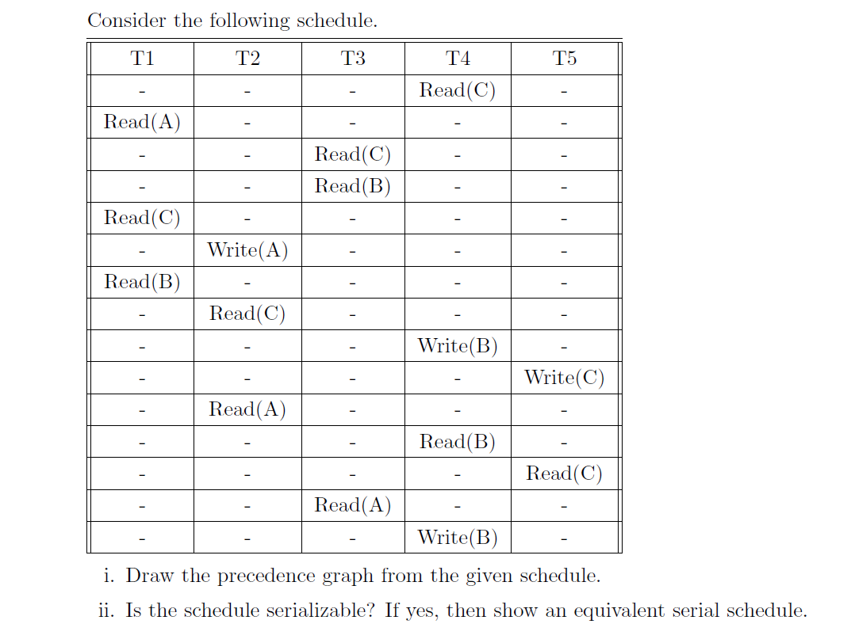
Conflict Serializability Check – 3
27

Slide 33
Simulator!!
28
https://devimam.github.io/dbtxn/

Slide 34
THANKS!
29
Any questions?
Email : imam@cse.uiu.ac.bd
Reference:
Database System Concepts by S. Sudarshan, Henry F. Korth, Abraham Silberschatz

